Slide 1

UE20CS390B – Capstone Project Phase – 2
Project Progress Review # 2
Project Title : Deploy EOX microservices using cloud platform service and improve scalability.
Project ID : PW_23_VP_01
Project Guide : Prof Venkatesh Prasad, Mr.Vijay R(EOX Vantage)
Project Team : Veena Garag PES1UG20CS492
Adarsh Kumar PES2UG20CS016
Suchit S Kallapur PES1UG20CS438
Yuvaraj D C PES1UG20CS521

Slide 2
Deploy eox microservices using cloud platform service and improve scalability.
Suggestions from Review 1
We were tasked to deploy the demo application to a production environment (live server).
Implementation of custom pod scaling algorithm

Slide 3
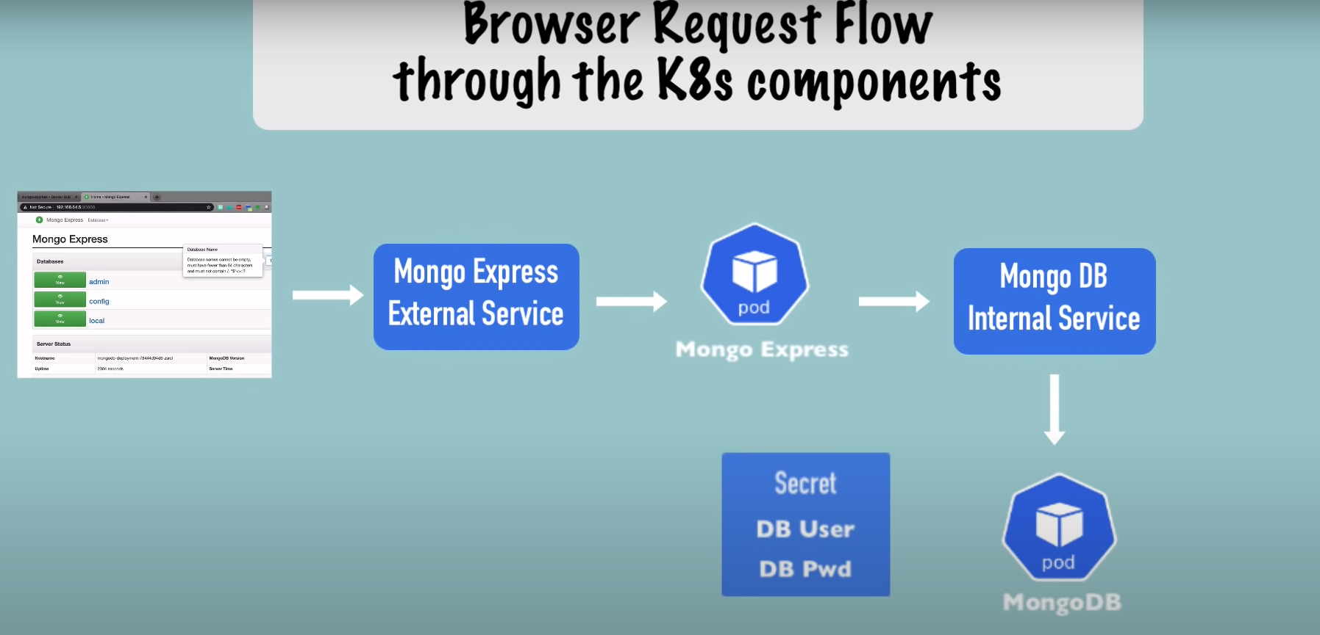
Deploy eox microservices using cloud platform service and improve scalability.
Proposed Approach / Methodology
Diagram of a browser request flow through the Kubernetes (K8s) components for a MongoDB application using Mongo Express.
Internal flow of request to MongoDB through Mongo Express

Slide 4
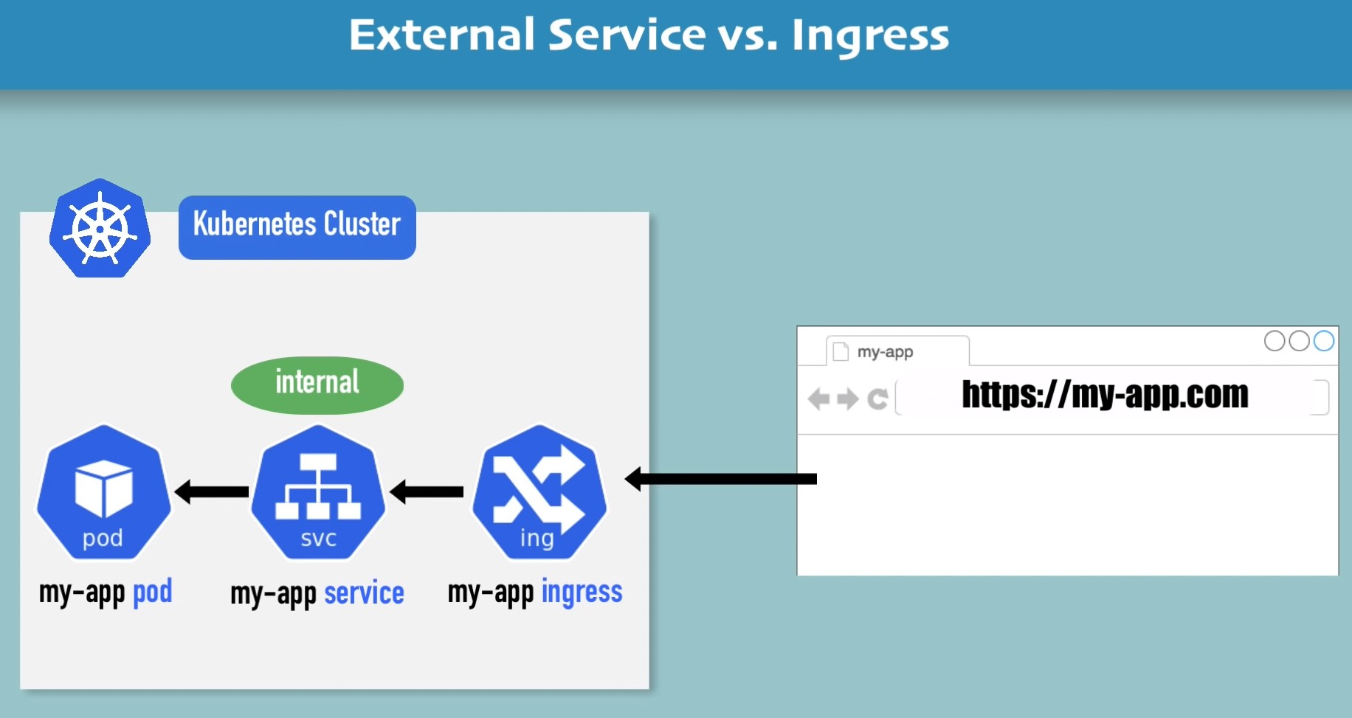
Deploy eox microservices using cloud platform service and improve scalability.
Proposed Approach / Methodology
Deployment of application using Ingress controller instead of External service
Kubernetes cluster with two Pods: my-app and my-ingress.
The my-app Pod is a regular Pod that runs the application.
The my-app external service is a LoadBalancer service that exposes the my-app Pod to the outside world.
The my-ingress Pod is an Ingress controller. Ingress resource is a Kubernetes resource that defines how traffic should be routed to the my-app external service.

Slide 5
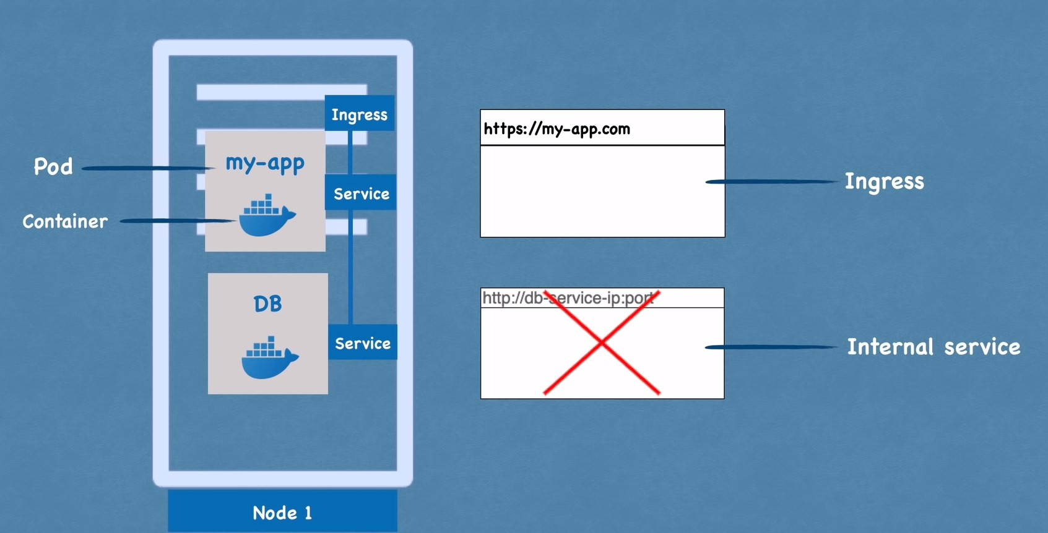
Deploy eox microservices using cloud platform service and improve scalability.
Proposed Approach / Methodology
Accessing applications using domain names

Slide 6
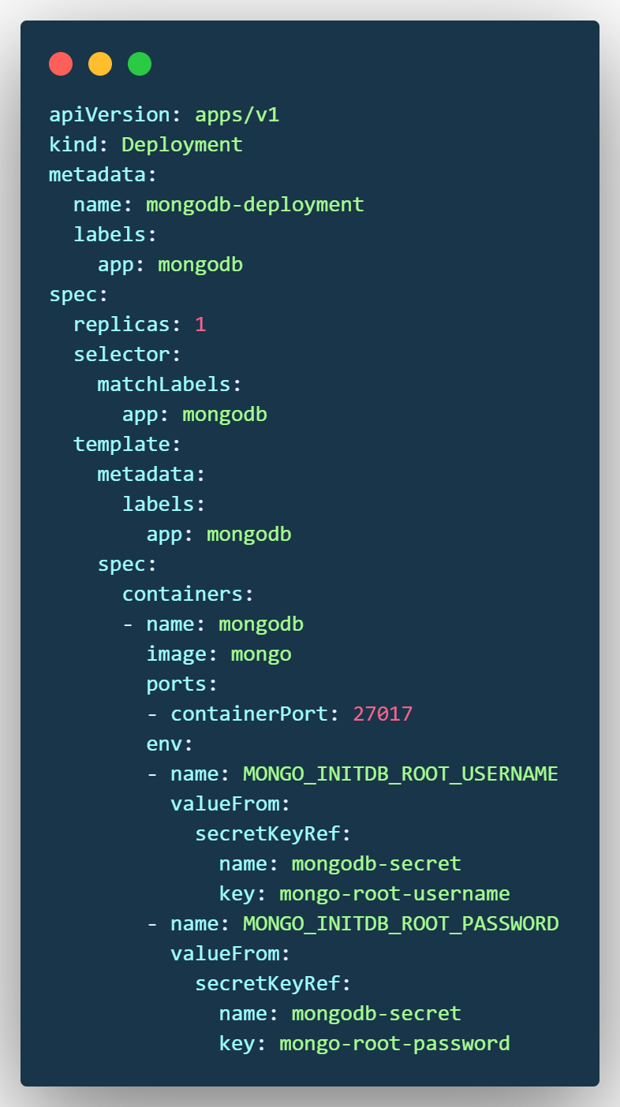
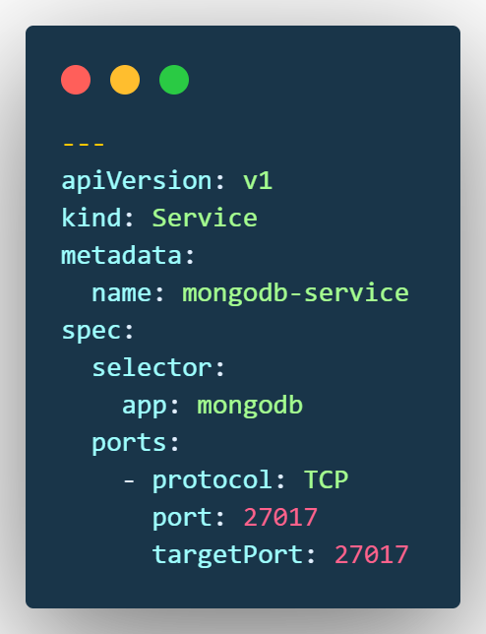
Deploy eox microservices using cloud platform service and improve scalability.
Algorithm & Pseudocode
Each configuration file has 3 parts:
Metadata
Specification
Status
mongo.yaml

Slide 7
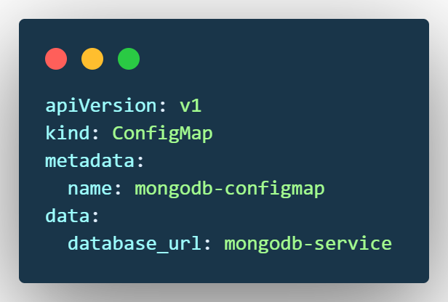
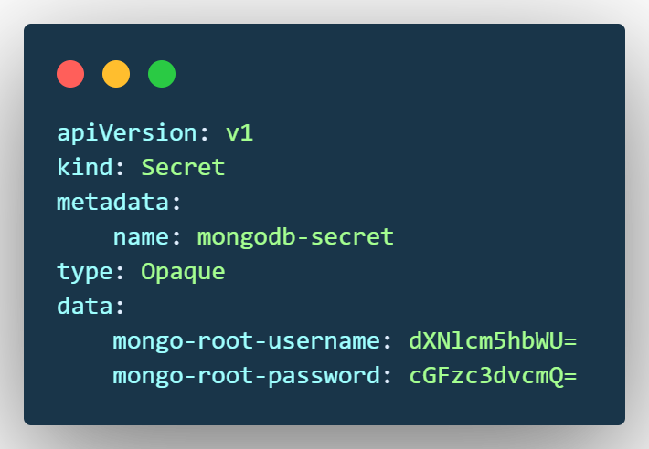
Deploy eox microservices using cloud platform service and improve scalability.
Algorithm & Pseudocode
mongo-configmap.yaml
mongo-secret.yaml
A Secret is an object in Kubernetes that stores sensitive data such as passwords, tokens, and keys.
Secrets are stored in base64 encoded form and can be accessed by Pods and other Kubernetes objects.

Slide 8
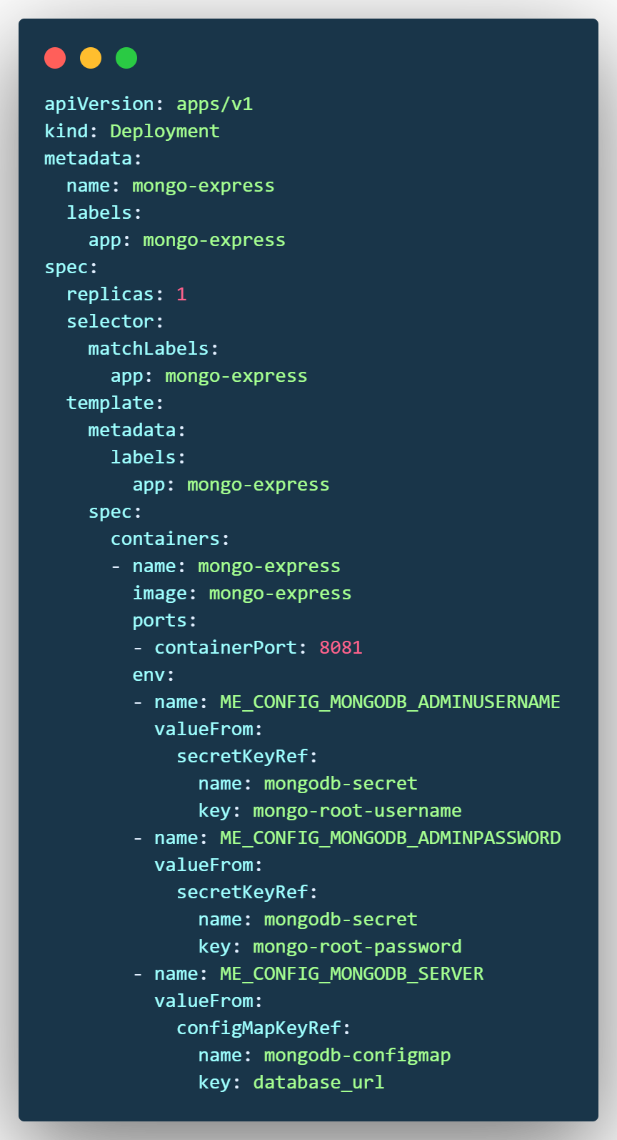
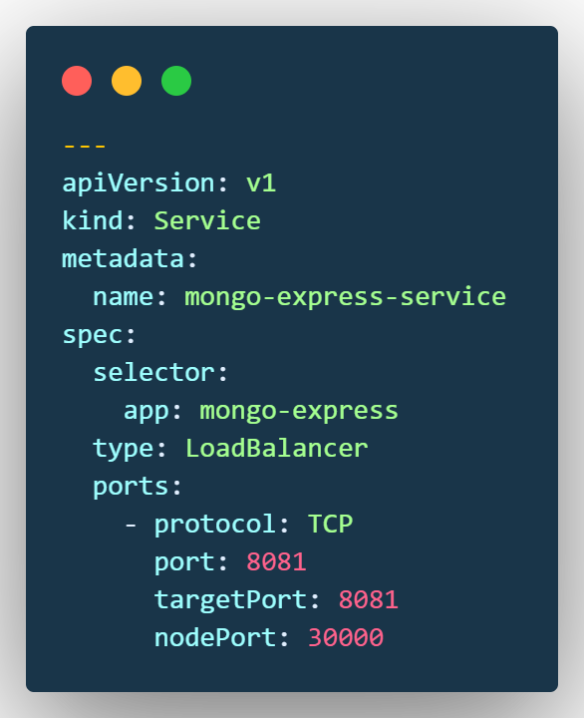
Deploy eox microservices using cloud platform service and improve scalability.
Algorithm & Pseudocode
mongo-express.yaml

Slide 9
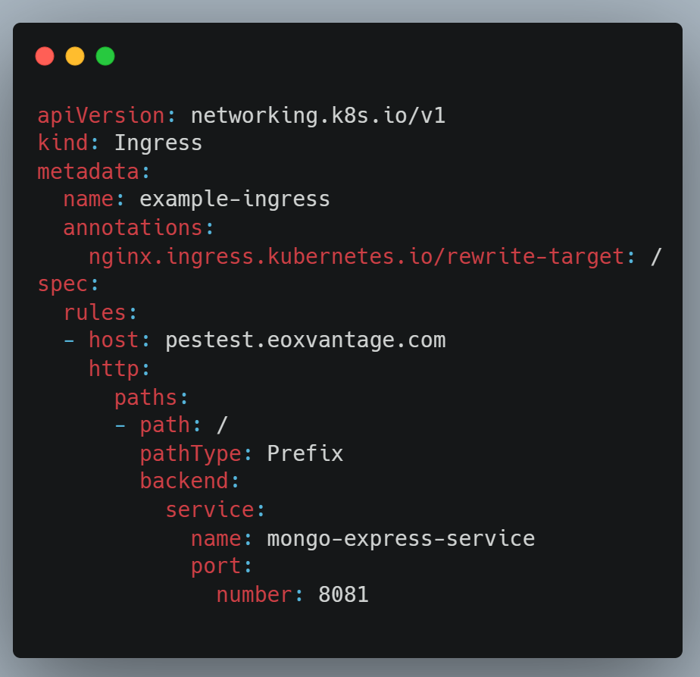
Deploy eox microservices using cloud platform service and improve scalability.
Algorithm & Pseudocode
Ingress resource that defines how traffic should be routed to your application.
The Ingress resource is a way to expose your application to the outside world, and it can be used to route traffic to specific services based on the path of the request, the hostname.
my-ingress.yaml

Slide 10
Deploy eox microservices using cloud platform service and improve scalability.
Design Approach
What is the design approach followed? And Why?
The design approach followed by us is NGINX Ingress Controller is to provide a simple and easy-to-use way to expose Kubernetes services to the outside world. It does this by providing a single point of entry for all traffic, and then routing that traffic to the appropriate service based on the path of the request, the hostname, or other factors.
Benefits of this approach & are there any drawbacks?
Benefits:
Wide range of features: NGINX Ingress Controller supports a wide range of features, including SSL/TLS termination, path-based routing, and load balancing.
Well-maintained: NGINX Ingress Controller is well-maintained and has a large community of users.
Drawbacks:
Performance: NGINX Ingress Controller can have a small impact on the performance of our application.
This is because it needs to inspect each request to determine where to route it.
Complexity: NGINX Ingress Controller can become complex to manage if we have a large number of services or
routing rules.
Alternate design approaches, if any.
Use a service mesh: A service mesh is a dedicated infrastructure layer that provides traffic management, security, and observability for microservices applications. Some examples of service mess will be Kuma or Traefik Mesh.

Slide 11
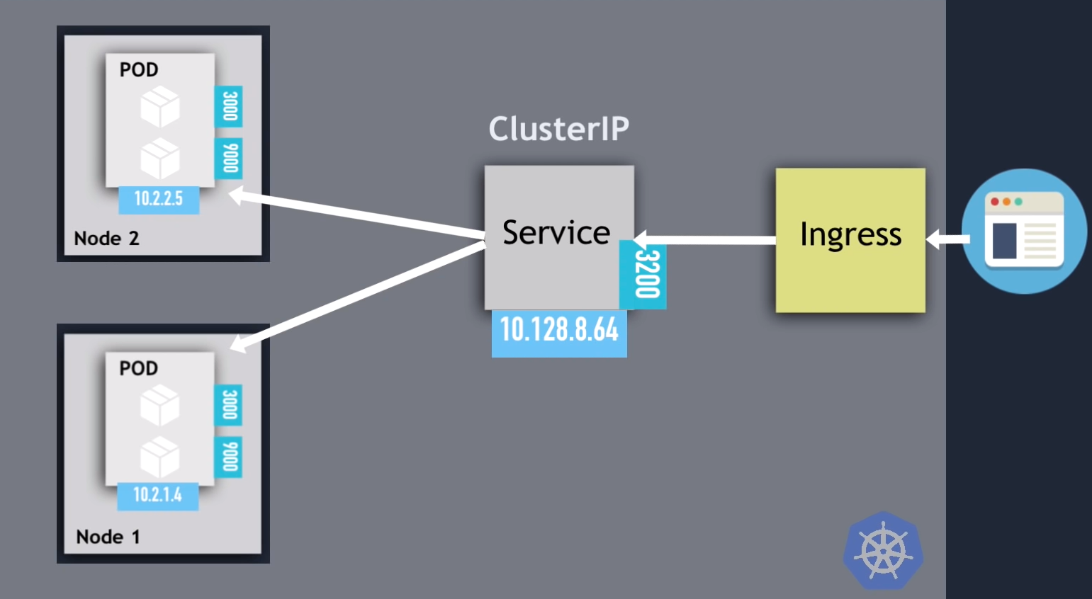
Deploy eox microservices using cloud platform service and improve scalability.
Design Description
Deployment Diagrams
Master class diagram, User case Diagram ➙ NA
Note: Applicable to prototype/product based project

Slide 12
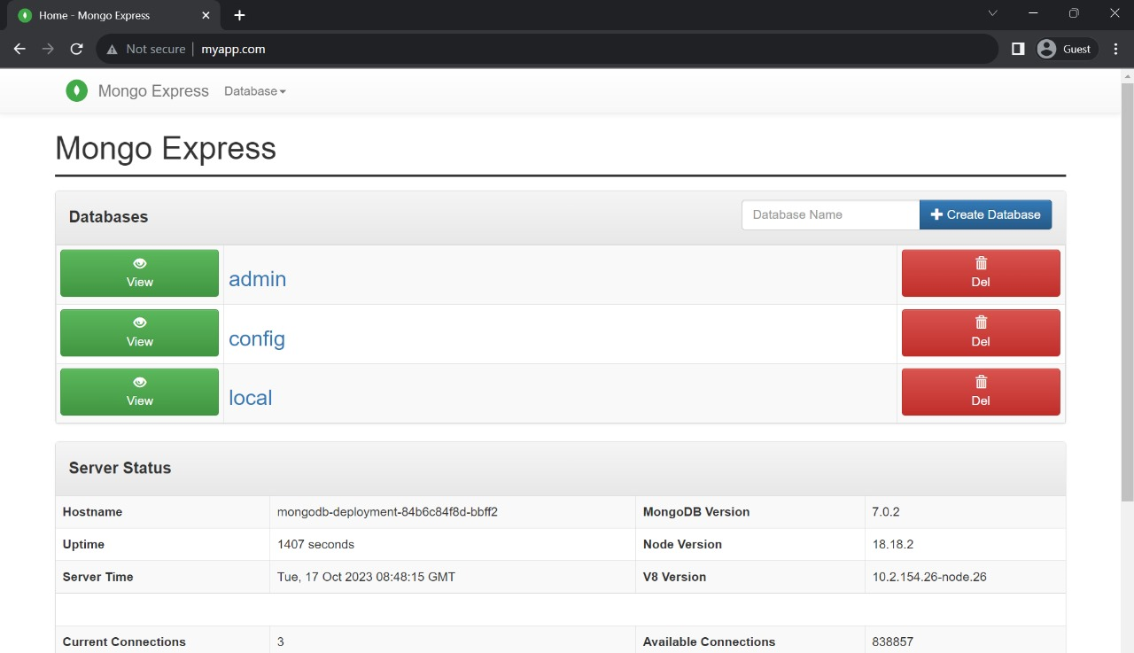
Deploy eox microservices using cloud platform service and improve scalability.
Demonstration and Testing of the Modules Completed
Successful deployment of a MongoDB application using the hostname myapp.com. The Mongo Express web application is running on the myapp.com hostname, and the MongoDB database is running on the mongodb-deployment- 84b6c84f8d-bbff2 hostname.

Slide 13
Deploy eox microservices using cloud platform service and improve scalability.
Conclusion
As expected by EOX Vantage we have deployed an MongoDB Mongo Express application onto their live server and successfully accessed it using the domain name using ingress controller instead of IP address and port number.
Task for Review 3
Implementation of Custom pod scaling algorithm

Slide 14
Deploy eox microservices using cloud platform service and improve scalability.
References
Deshpande, Neha (2021) Autoscaling Cloud-Native Applications using Custom Controller of Kubernetes.
https://norma.ncirl.ie/5089/
Masters thesis, Dublin, National College of Ireland.
Shitole, Abhishek Sanjay (2022) Dynamic Load Balancing of Microservices in Kubernetes Clusters using Service Mesh.
https://norma.ncirl.ie/5943/
Masters thesis, Dublin, National College of Ireland.
An Efficient and Scalable Traffic Load Balancing Based on Web Server Container Resource Utilization using Kubernetes Cluster.(May – 2022) Ashok L Pomnar,
AVCOE Sangamner 422 605,Maharashtra, India.
https://ijisrt.com/assets/upload/files/IJISRT22MAY1644_(1)_(1).pdf
V. Sharma, "Managing Multi-Cloud Deployments on Kubernetes with Istio, Prometheus and Grafana," 2022 8th International Conference on Advanced Computing and Communication Systems (ICACCS), Coimbatore, India,
https://doi.org/10.1109/ICACCS54159.2022.9785124

Slide 15
Thank You

